Slide 1
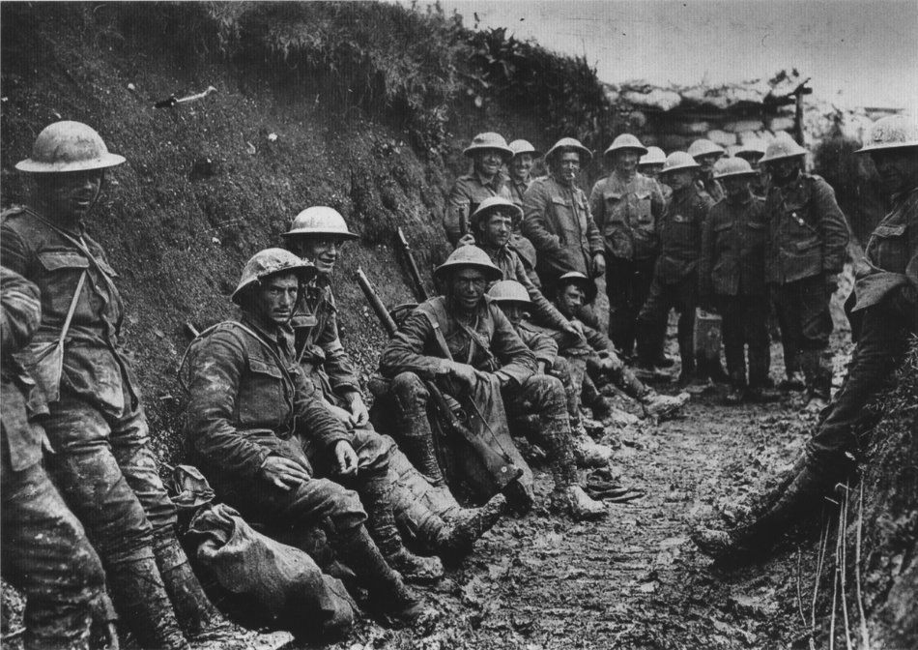
WORLD WAR I “The Great War”
World War I
“The Great War”
19-14-1918
19-14-1918

Slide 2
Long Term Causes
Nationalism-
Deep Devotion to One’s Nation
Competition and Rivalry developed between European nations for territory and markets.

Slide 3
Long Term Causes
Militarism-
Glorifying Military Power
Keeping a large standing army prepared for war
Arms race for military technology

Slide 4
Long Term Causes
Imperialism-
European competition for colonies
Quest for colonies often almost led to war
Imperialism led to rivalry and mistrust amongst European nations

Slide 5
Long Term Causes
Alliance System-
Designed to keep peace in Europe, instead pushed continent towards war
Many Alliances made in secret
By 1907 two major alliances: Triple Alliance and Triple Entente

Slide 6
The Two Sides
Triple Alliance
Germany
Austria-Hungary
Italy
Central Powers
Germany
Austria-Hungary
Ottoman Empire
Triple Entente
England
France
Russia
Allied Powers
England, France, Russia, United States, Italy, Serbia, Belgium, Switzerland

Slide 7
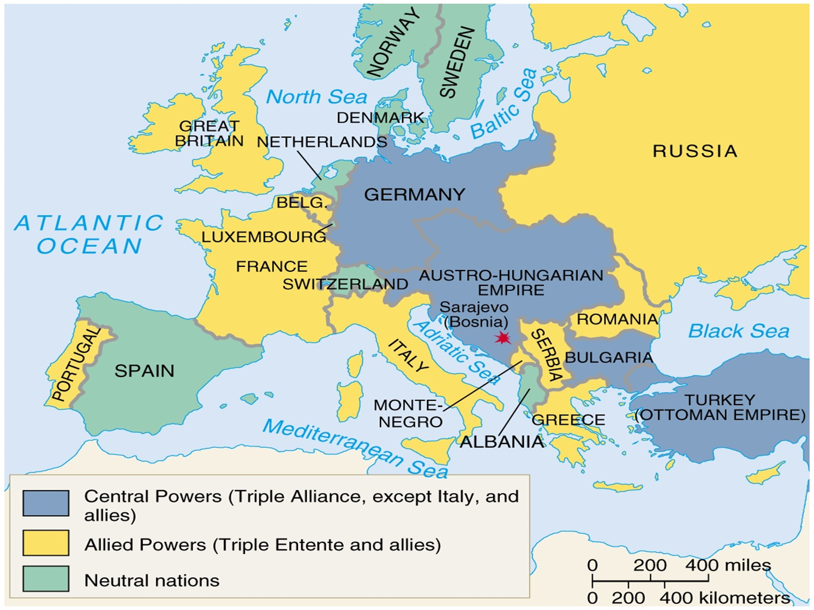

Slide 8
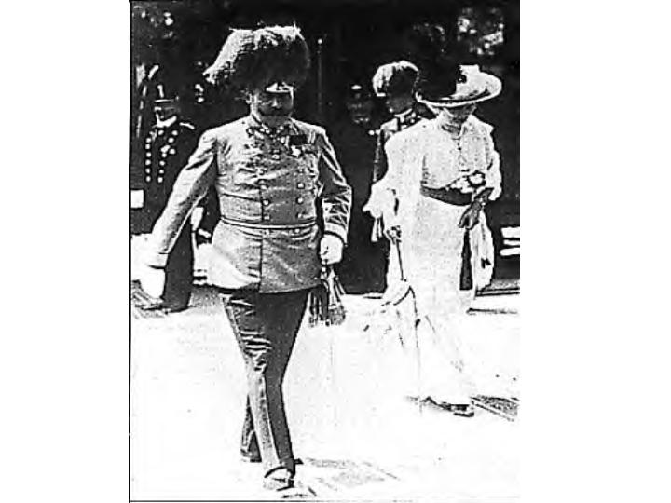
Short-Term Cause/Spark
June 28th, 1914
Assassination of
Franz Ferdinand
Austro-Hungarian
Killed by Serbian/Bosnian
assassins

Slide 9
Who Declared War on Who?
Austria-Hungary Declares War on Serbia
Russia Declares War on Austria Hungary
Germany Declares War on Russia
Germany Declares War on France
England Declares War on Germany and Austria Hungary

Slide 10
Summer of 1914
Triple Entente/Triple Alliance Actions
July 28th Austria-Hungary declares war on Serbia
July 29th Russia Mobilizes its troops
August 1, 1914 Germany mobilizes troops.
August 2nd Germany declares war on Russia.
August 3: Germany declares war on France
August 4: Germany declares war on Belgium and invades it,
August 4: England declares war on Germany
August 5: Austria declares war on Russia and Great Britain

Slide 11
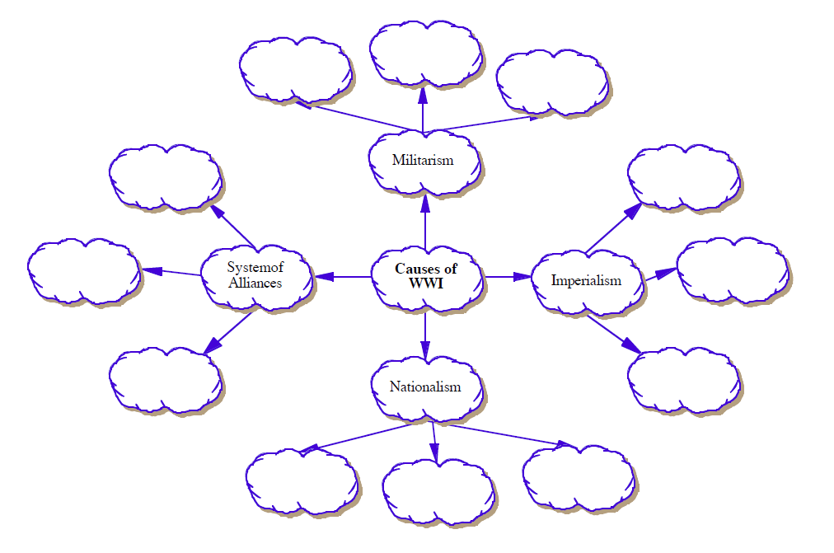

Slide 12
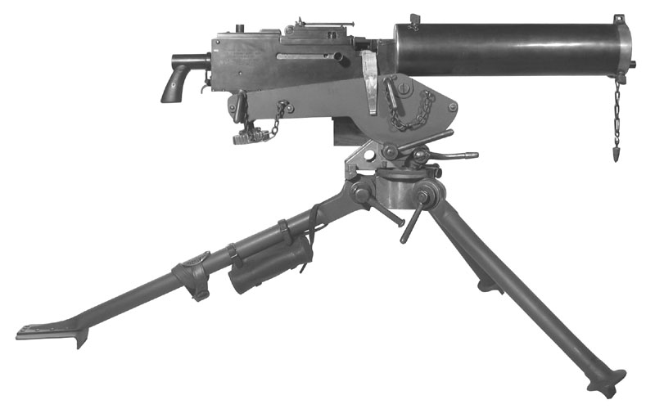

Slide 13
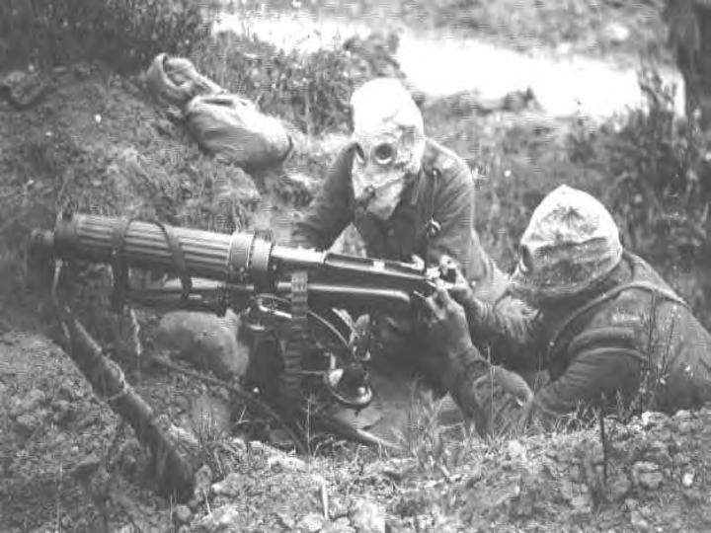

Slide 14
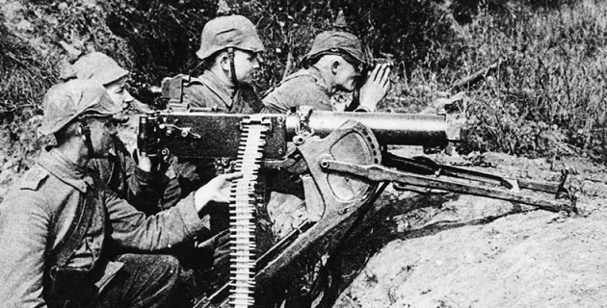

Slide 15
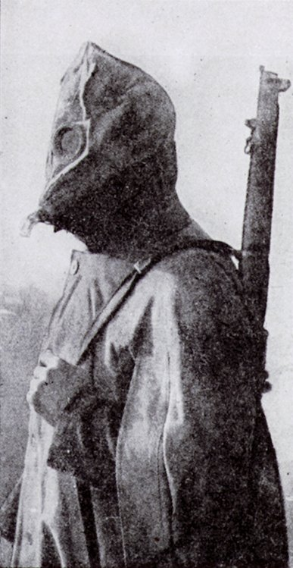

Slide 16
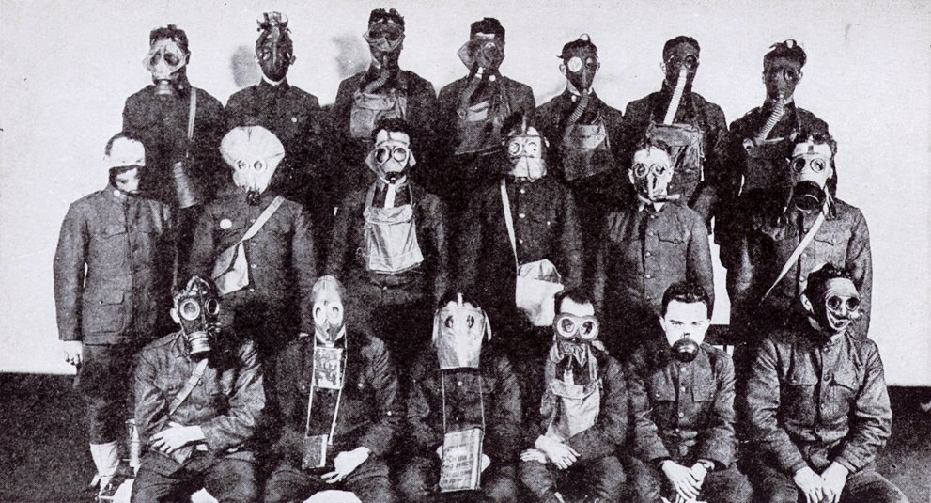

Slide 17
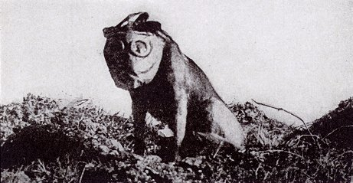

Slide 18
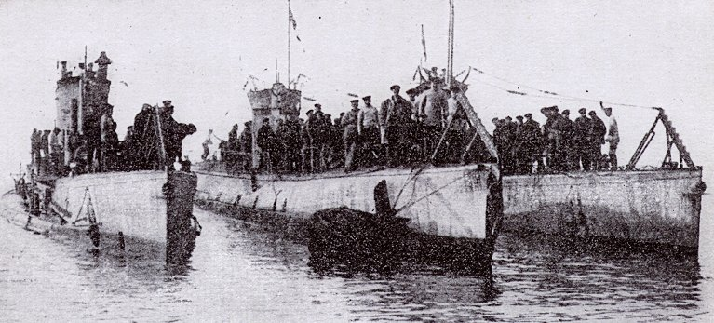

Slide 19
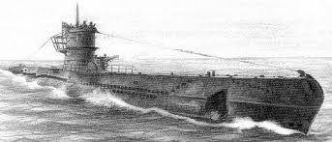

Slide 20
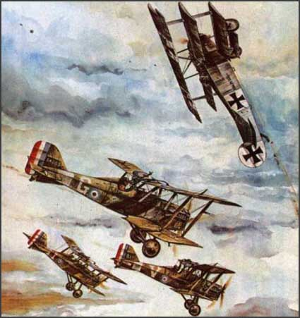

Slide 21
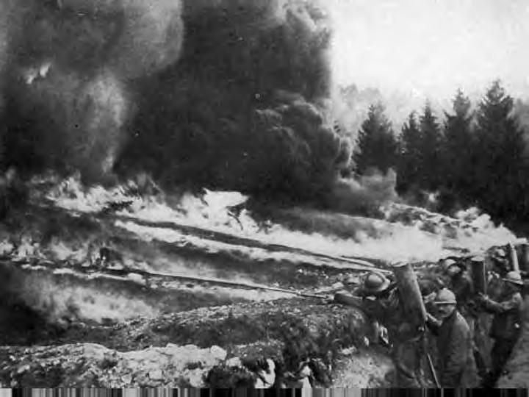

Slide 22
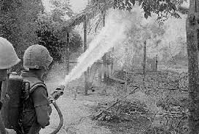

Slide 23
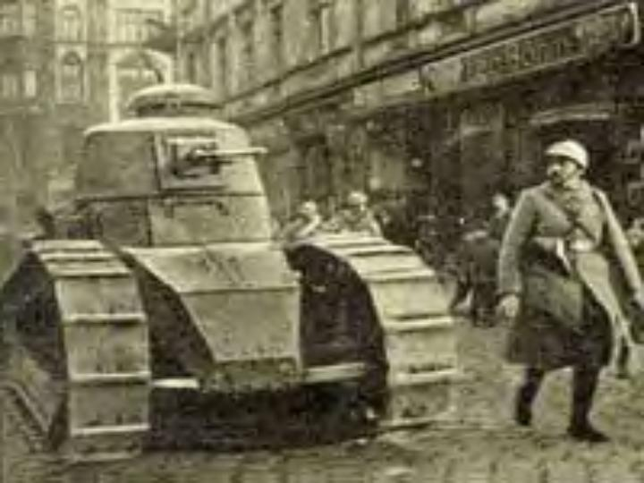

Slide 24
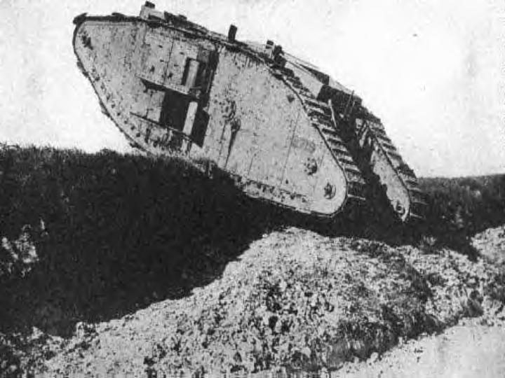

Slide 25
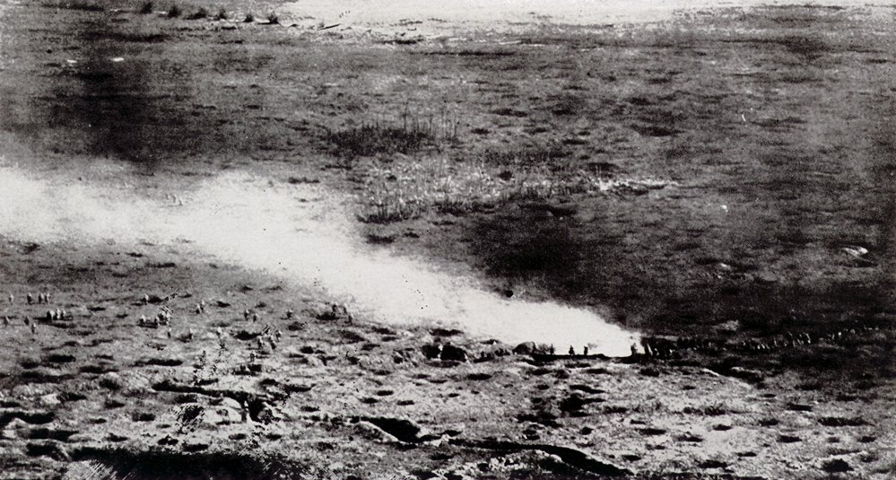

Slide 26
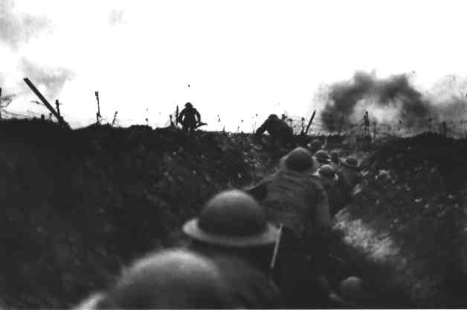

Slide 27
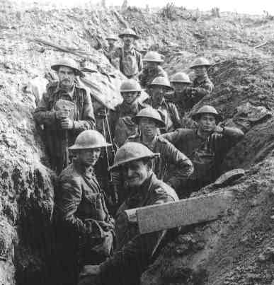

Slide 28
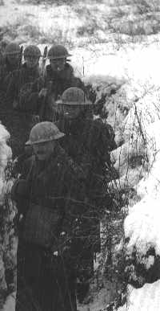

Slide 29
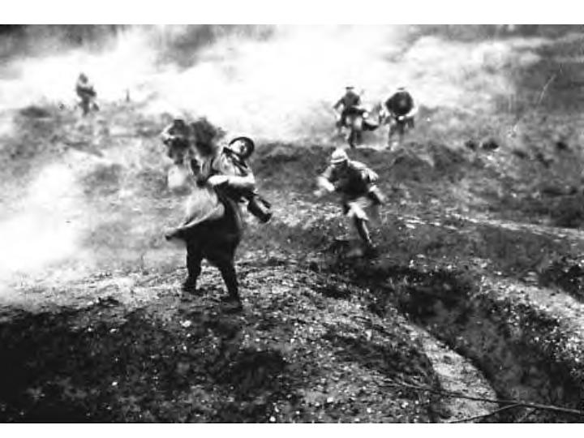

Slide 30
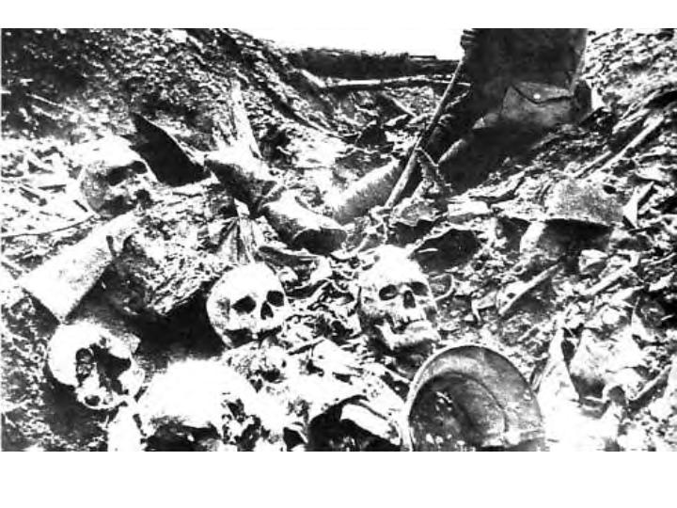

Slide 31
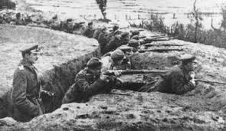

Slide 32
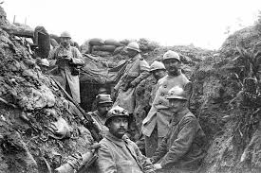

Slide 33
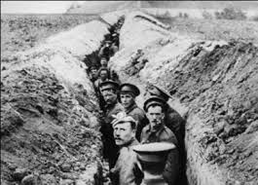

Slide 34
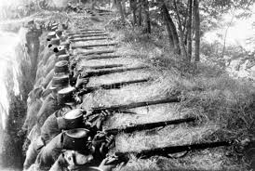

Slide 35
US Involvement in WWI

Slide 36
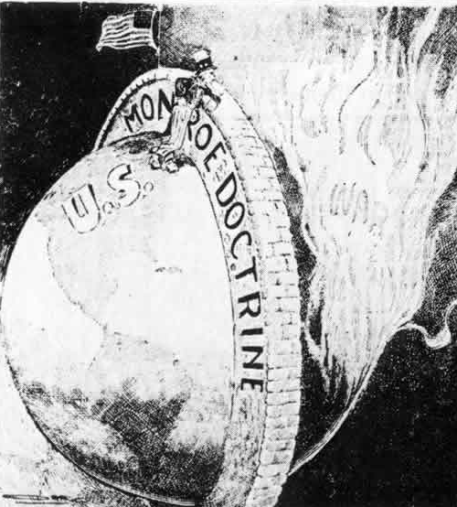
Why did it take so long for America to get involved in the war?
America was Isolationist.
What Does This Mean?
Turn and Talk
The Monroe Doctrine (1823) sought to
isolate “the American continents” from
European influences and problems.
In this cartoon, “The Great Wall” (1914), the Monroe Doctrine is shown as a protective shield for the United States.

Slide 37
Isolationism
Is isolationism really an option for a country as powerful as the United States?
What are the disadvantages of isolationism?
What are the advantages?

Slide 38
US claims Neutrality
Throughout WWI, The US made attempts remain Neutral.
Do you agree?
Do you disagree?
Song depicting the attitudes of the US
http://historymatters.gmu.edu/d/4942/

Slide 39
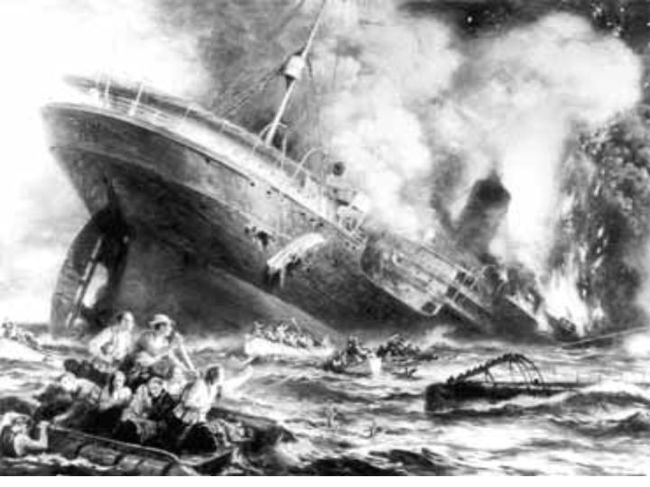
May 7th 1915
Sinking of the Lusitania

Slide 40
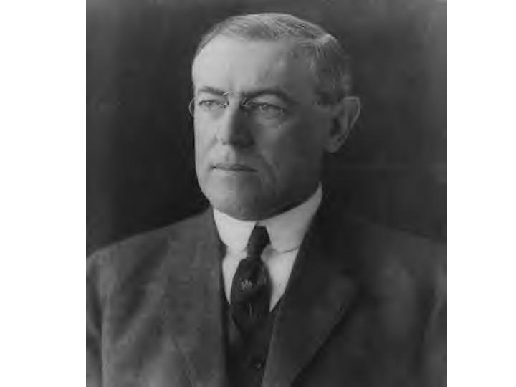
1916 Presidential Election
Woodrow Wilson
Because
“he kept us out of the war”

Slide 41
The Congressional Decision is………

Slide 42
THE US WILL DECLARE WAR!

Slide 43
US Declares War
Senate Declares War April 4th 1917
House of Representatives Declares War April 6th 1917
Wilson’s reasoning for War
make the world “Safe for Democracy”

